Slide 1
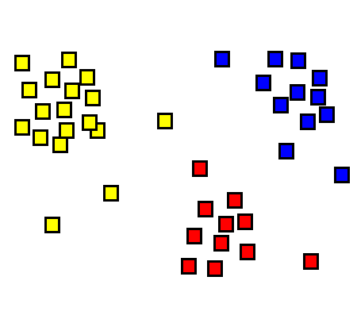
CloudClustering
Toward a scalable machine learning toolkit for Windows Azure
Ankur Dave XCG Intern
Microsoft Research
Mentors:
Roger Barga
Wei Lu
August 12, 2010
Notes:
Hi everyone! Thanks for taking the time to come to my presentation.
I’m Ankur Dave. I’m an intern in XCG, and I’ll be talking to you today about my project this summer: CloudClustering.

Slide 2
Agenda
Notes:
Here’s the layout of what I’ll be talking about. I’ll cover what went into CloudClustering, how the system actually works, and the findings from this research.
There’s a lot of content to cover, so I’ll move quickly, but please do stop me whenever you have any questions.

Slide 3
Agenda
Notes:
First, a little about me.

Slide 4
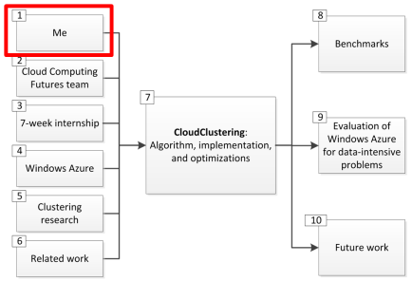
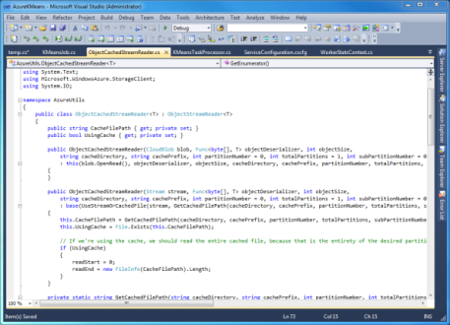
About me
Education
Work
Hobbies
Notes:
I’m a high school intern entering college this fall. I graduated from Interlake High School, and I’m joining UC Berkeley as a computer science major – in just two weeks.
This is actually my fifth job.
Last summer I interned at Harvard University’s Berkman Center for Internet and Society building a publish-and-subscribe system for their Internet censorship reporter.
Earlier I interned at DreamBox, an educational startup in Bellevue where I built interactive UI components.
I’ve also worked at the Jain Foundation, a nonprofit working to find a cure for muscular dystrophy. I built functionality for patients and researchers to connect.
At CH2M Hill, an international engineering company, I worked on building social media widgets.
In my free time I like playing Set (a pattern-matching game) and Halo, and of course writing code ☺

Slide 5
Agenda
Notes:
I am part of the Cloud Computing Futures team within the eXtreme Computing Group.

Slide 6
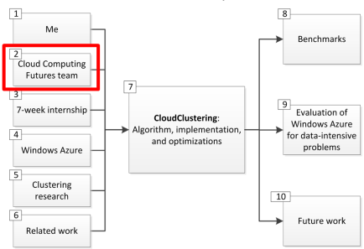
My team
Dan Reed
Dennis Gannon
Jaliya Ekanayake
Jared Jackson
Nelson Araujo
Roger Barga
Wei Lu
Notes:
I’m working on the Azure Research Engagement project.
Our team addresses the following problem: Scientists who work with large amounts of data usually want to focus on doing research, not on maintaining hundreds of machines to process their data.
The cloud is the perfect solution – all of the infrastructure is taken care of behind the scenes, leaving scientists free to focus on research. So my team’s goal is to support scientists in their adoption of the cloud.
One of our initiatives is an open-source machine learning toolkit on the cloud. My project this summer is a contribution to that effort.

Slide 7
Agenda
Notes:
My internship was just 7 weeks long, so it was a pretty fast-paced project. Here’s what I covered…

Slide 8
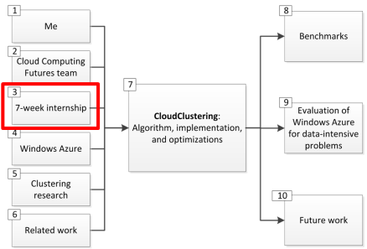
Internship: Domain
Machine learning
Clustering
Implementation on Windows Azure
Goals:
Build a scalable clustering algorithm on Azure
Explore clustering and the cloud by reading papers
Meet a variety of researchers at MSR
Week 1: Ramp-up; architecture planning
Week 2: Building CloudClustering base impl.
Week 3: Building CloudClustering base impl.
Week 4: Multicore parallelism with PLINQ
Week 5: Performance testing on Azure fabric
Week 6: Multicore w/threads; data affinity
Week 7: Presentation and report-out
Notes:
The overall domain was in the field of machine learning, which has to do with the design of algorithms that draw useful conclusions from complex data.
Within the field of machine learning, I worked with the problem of clustering on the Windows Azure platform.

Slide 9
Agenda
Notes:
CloudClustering was built on Windows Azure and is adapted to its features, so here’s an overview.

Slide 10
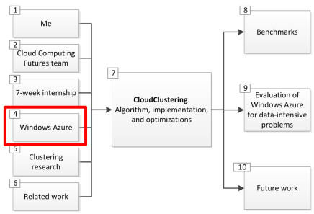
Windows Azure
Exploring
for data-intensive research
Notes:
Windows Azure, of course, is Microsoft’s cloud platform.
My goal this summer was to explore how suitable Azure is for data-intensive research, by building a large-scale clustering algorithm on Azure that is the first step towards a machine learning toolkit on the cloud.

Slide 11
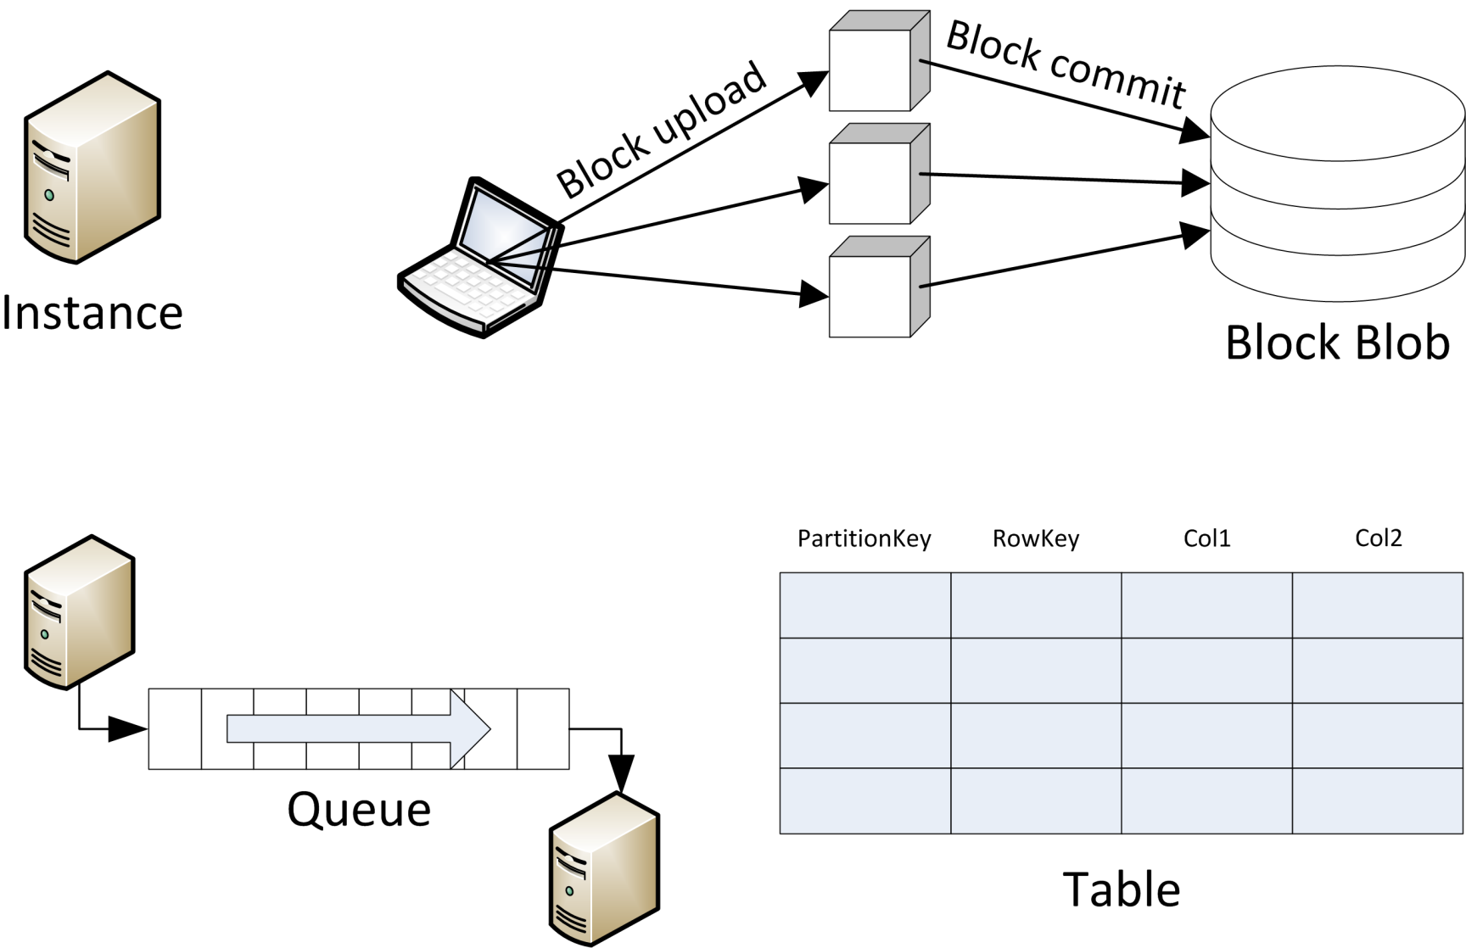
Windows Azure
Notes:
Here are some key terms in Azure. I’ll be using these throughout the rest of the talk.
Instance: A virtual machine managed by Windows Azure that runs user code.
Block Blobs: Store named files. Random reads are supported. Writes must be done in blocks, which are uploaded in any order and then committed in the order they should appear.
Queues: Reliably deliver small messages between instances.
Tables: Store query-able lists of entities. Not a relational database, so you can’t do cross-table queries.

Slide 12
Agenda
Notes:
Clustering was the problem that I was attempting to solve. Here’s some background into that.

Slide 13
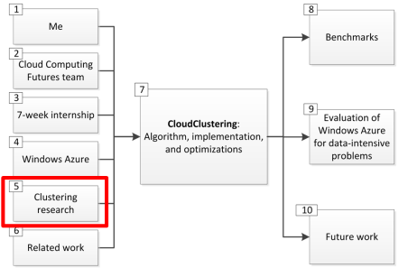
Clustering
Notes:
Clustering is assigning a set of data points into similar subsets. It’s heavily used in machine learning and data mining. There are many examples of clustering. Here’s just one…

Slide 14
Clustering
Notes:
This is Bing News. Every article has a link to “More stories,” that takes you to…

Slide 15
Clustering
Notes:
… a list of news articles about the same topic.
Bing News uses clustering to group articles together, so it can show these kinds of lists.

Slide 16
Clustering
$k$-means
Minimizes the within-cluster sum of squares:
$$\sum_{i=1}^{k}{\sum_{p∈C_{i}}{{||p−μ_{i}||}^{2}}}$$
}
}
}
Distance from point to centroid
For each cluster
For each point in the cluster
$$k=3$$
Notes:
One popular clustering algorithm is called k-means.
The name comes from the fact that it groups data points around k mean points, such that the sum of the r-squared distances from each point to its cluster’s mean point is minimized.
We start with a set of data points, and a value for how many clusters to group them into -- k.

Slide 17
Clustering
Target clustering
Notes:
As humans, we know that the points should probably be clustered like this. I’ll briefly step through how the k-means algorithm arrives at this result.

Slide 18
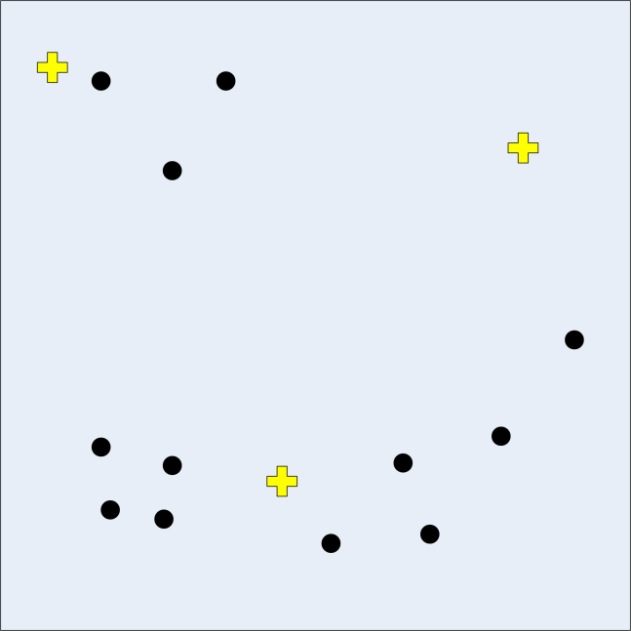
Clustering
1. Initialization
$$k=3$$
Notes:
First we generate k random centroids. Centroids are special points that define each cluster. Every point in a cluster is closer to that cluster’s centroid than to any other centroid.

Slide 19
Clustering
2. Assign Points to Centroids #1
Notes:
After generating the random centroids, we assign each point to the closest centroid. This is k-means’s first pass at clustering.

Slide 20
Clustering
3. Recalculate Centroids #1
Notes:
Now we’re starting the second pass. We improve the centroids by moving them to the average – mean – of the points that they own.

Slide 21
Clustering
4. Assign Points to Centroids #2
Notes:
So now we do the same thing as before -- we assign each point to the closest centroid. The clusters are looking better now.

Slide 22
Clustering
5. Recalculate Centroids #2
Notes:
Again we move the centroids to the average of the points that they own.

Slide 23
Clustering
Stopping Condition
Notes:
And so on, until no points move between clusters from one iteration to the next. That’s our stopping condition.

Slide 24
Agenda
Notes:
Finally, here’s some prior work related to CloudClustering.

Slide 25
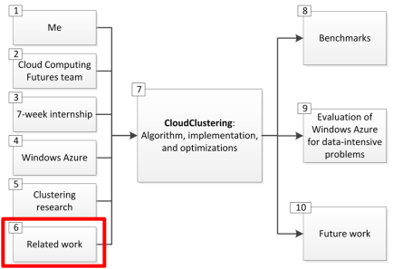
Related Work
Notes:
K-Means has been implemented on a variety of frameworks – MapReduce, Dryad…
There’s even a relatively simple Azure implementation called Cloudster.
This work helps give insights into the basic structure of CloudClustering, our Azure k-means implementation.
CloudClustering builds off of this knowledge, and additionally takes advantage of Azure-specific features that offer increased performance.
And the deeper goal with CloudClustering is to gain experience in building data-intensive algorithms for Azure.

Slide 26
Agenda
Notes:
Now I’ll go into detail about the CloudClustering system.

Slide 27
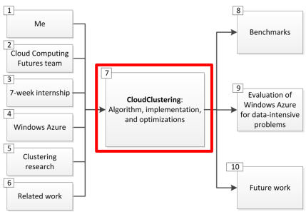
CloudClustering: Algorithm
Conventional (Serial) $k$-means
Notes:
Here’s the k-means algorithm we just saw. This is serial – it only runs on one machine. This will be slow for large data sets.

Slide 28
CloudClustering: Algorithm
Parallel $k$-means
Notes:
Here is how to parallelize k-means so that it can run on multiple machines.
We split up the points into partitions and give one partition to each worker. The workers then assign their partition of points to centroids.
The very important difference lies in how the centroids are recalculated.
In the serial algorithm, we sum up all of the points in each cluster, and divide that by the number of points in the cluster. That gives us the average.
If we had the server do that in the parallel algorithm, it would have to iterate over all the points all over again. There must be a better way.
And there is --
The workers calculate the sum of all of the points in each cluster in their partition, and the number of points in each cluster in their partition.
But then instead of dividing these two number to get an average for the partition, they just return the two number separately.
Then, to find the new location of a particular centroid, the server just has to add up all the point sums for that centroid, and all the numbers of points for that centroid, and divide those two to get the new average centroid location.
Essentially, the final location for a particular centroid is the weighted average of all the workers’ opinions of where it should be.

Slide 29
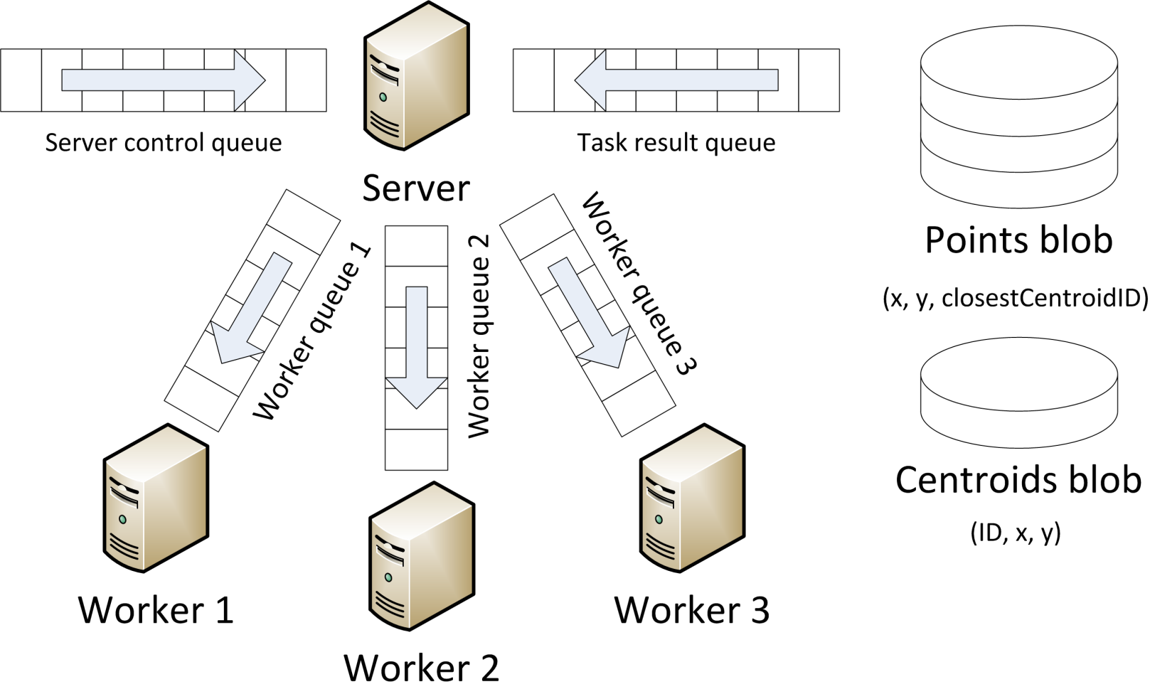
CloudClustering: Implementation
Notes:
Here is how CloudClustering implements that parallel algorithm on Azure. I’ll walk you through how each step of the algorithm maps to Azure.

Slide 30
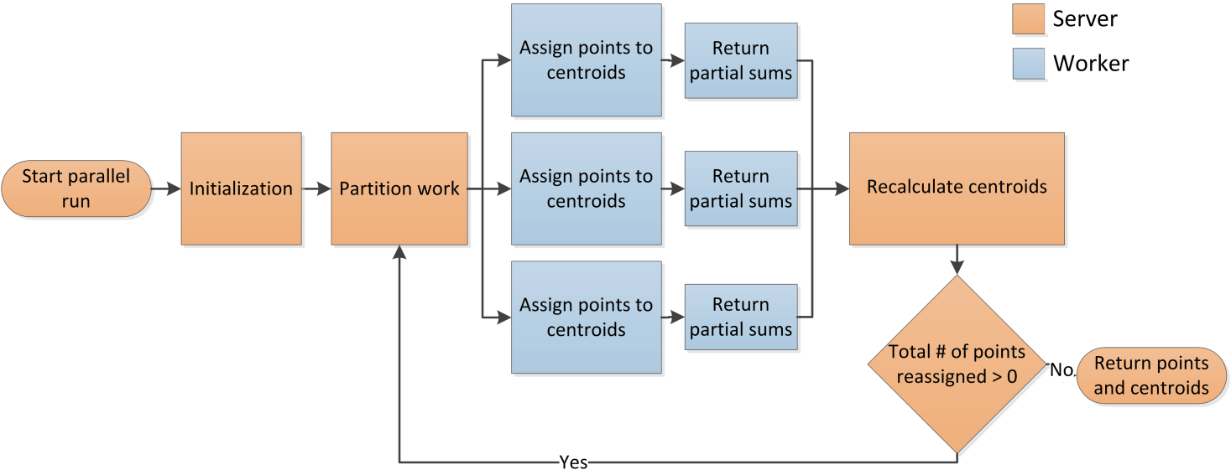
CloudClustering: Implementation
Notes:
In the initialization step, a Server instance creates two blobs: one containing a list of points, and one containing a list of random centroids.
In the Split Points into Partitions step, the Server uses queue messages to assign each worker a partition of those points.
Each worker assigns its partition of points to the closest centroids, and updates the points in the central blob.
Each worker calculates the partial point sum and number of points that belong to each centroid. It also calculates the number of points reassigned to new centroids. (This actually happens during the previous step to avoid iterating over the data twice.) It returns this data to the Server using queue messages.
The server recalculates the centroids using the data returned by the workers. For each centroid, it divides the total point sum by the total number of points to find the new centroid.
If the total number of points changed by the workers is greater than 0, then the server starts a new iteration, splitting the points blob into partitions and assigning each one to a worker.

Slide 31
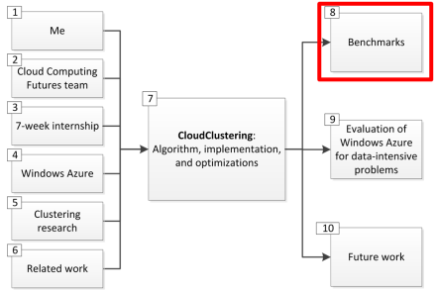
CloudClustering: Leveraging the cloud
Multicore Parallelism
Data Affinity
Efficient Blob Concatenation
Dynamic Scalability
Notes:
Next I’d like to go in depth into these four features of CloudClustering. Each one leverages a unique property of the cloud.

Slide 32
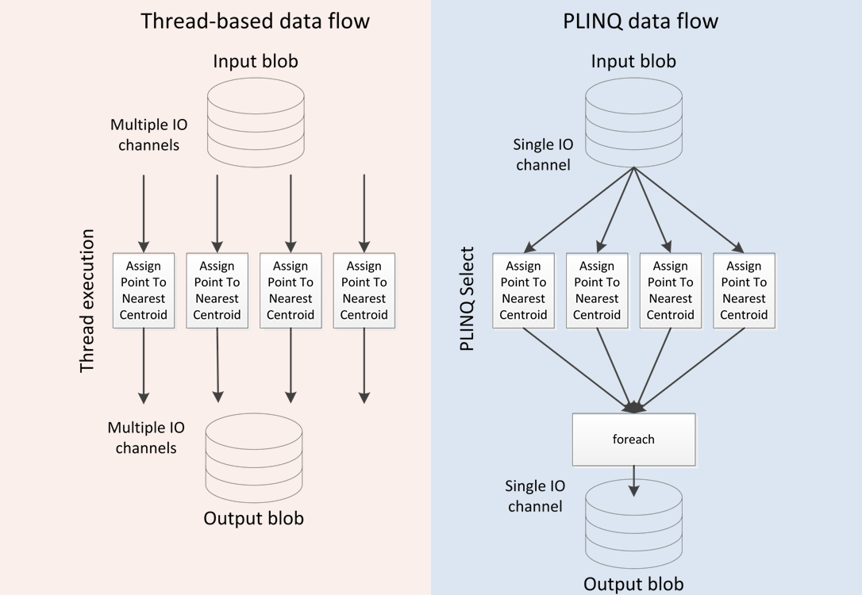
CloudClustering: Multicore Parallelism
Notes:
Azure provides a way to ask for instances with 1, 2, 4, or 8 cores, through a parameter called the instance size.
CloudClustering uses threads to take advantage of these cores. Each thread opens a separate input and output stream to get the points in its partition and process them. Distributing the I/O across threads helps to take advantage of the network bandwidth.
Another way to do this is to use PLINQ, a .NET language feature that automatically handles parallelism on the element level rather than the thread level. It parallelizes operations on IEnumerable data, which in this case is the input point stream.
I implemented both approaches, PLINQ and threads. Here’s what the code for each looks like.

Slide 33
Thread-based
PLINQ
private void ProcessPoints()
{
CloudBlockBlob pointsBlob = AzureHelper.GetBlob(task.Points);
// Do the mapping and write the new blob
int numThreads = Environment.ProcessorCount;
PointsProcessedData[,] pointSumsPerCentroidPerThread = new PointsProcessedData[numThreads, task.K];
int[] pointsChangedPerThread = new int[numThreads];
string[][] blockIDsPerThread = new string[numThreads][];
System.Threading.Tasks.Parallel.For(0, numThreads, threadID =>
{
using (ObjectCachedStreamReader<ClusterPoint> stream = new ObjectCachedStreamReader<ClusterPoint>(pointsBlob, ClusterPoint.FromByteArray, ClusterPoint.Size, AzureHelper.GetLocalResourceRootPath("cache"), task.JobID.ToString(), task.PartitionNumber, task.M, subPartitionNumber: threadID, subTotalPartitions: numThreads))
{
// Process the points
ObjectBlockWriter<ClusterPoint> writeStream = new ObjectBlockWriter<ClusterPoint>(pointsBlob, point => point.ToByteArray(), ClusterPoint.Size);
foreach (var point in stream)
{
// Assign the point to the nearest centroid
Guid oldCentroidID = point.CentroidID;
int closestCentroidIndex = centroids.MinIndex(centroid => Point.Distance(point, centroid));
Guid newCentroidID = point.CentroidID = centroids[closestCentroidIndex].ID;
// Write the updated point to the writeStream
writeStream.Write(point);
// Update the number of points changed
if (oldCentroidID != newCentroidID)
{
pointsChangedPerThread[threadID]++;
}
// Update the point sums
if (pointSumsPerCentroidPerThread[threadID, closestCentroidIndex] == null)
{
pointSumsPerCentroidPerThread[threadID, closestCentroidIndex] = new PointsProcessedData();
}
pointSumsPerCentroidPerThread[threadID, closestCentroidIndex].PartialPointSum += point;
pointSumsPerCentroidPerThread[threadID, closestCentroidIndex].NumPointsProcessed++;
}
// Collect the block IDs from writeStream
writeStream.FlushBlock();
blockIDsPerThread[threadID] = writeStream.BlockList.ToArray();
}
});
// Combine the per-thread block lists and write the full block list to a blob. Then include that as part of TaskResult
List<string> blockIDs = new List<string>();
foreach (string[] blockIDsFromThread in blockIDsPerThread)
{
blockIDs.AddRange(blockIDsFromThread);
}
CloudBlob blockIDsBlob = AzureHelper.CreateBlob(task.JobID.ToString(), Guid.NewGuid().ToString());
using (Stream stream = blockIDsBlob.OpenWrite())
{
BinaryFormatter bf = new BinaryFormatter();
bf.Serialize(stream, blockIDs);
}
TaskResult.PointsBlockListBlob = blockIDsBlob.Uri;
// Total up the per-thread pointSumsPerCentroid
TaskResult.PointsProcessedDataByCentroid = new Dictionary<Guid, PointsProcessedData>();
for (int i = 0; i < task.K; ++i)
{
Guid centroidID = centroids[i].ID;
TaskResult.PointsProcessedDataByCentroid[centroidID] = new PointsProcessedData();
for (int j = 0; j < numThreads; ++j)
{
if (pointSumsPerCentroidPerThread[j, i] != null)
{
TaskResult.PointsProcessedDataByCentroid[centroidID].PartialPointSum += pointSumsPerCentroidPerThread[j, i].PartialPointSum;
TaskResult.PointsProcessedDataByCentroid[centroidID].NumPointsProcessed += pointSumsPerCentroidPerThread[j, i].NumPointsProcessed;
}
}
}
// Total up the per-thread numPointsChanged
TaskResult.NumPointsChanged = 0;
foreach (int threadPointsChanged in pointsChangedPerThread)
{
TaskResult.NumPointsChanged += threadPointsChanged;
}
}
private void ProcessPoints()
{
CloudBlockBlob pointsBlob = AzureHelper.GetBlob(task.Points);
// Do the mapping and write the new blob
using (ObjectStreamReader<ClusterPoint> stream = new ObjectStreamReader<ClusterPoint>(pointsBlob, ClusterPoint.FromByteArray, ClusterPoint.Size, task.PartitionNumber, task.M))
{
var assignedPoints = stream.AsParallel().Select(AssignClusterPointToNearestCentroid);
ObjectBlockWriter<ClusterPoint> writeStream = new ObjectBlockWriter<ClusterPoint>(pointsBlob, point => point.ToByteArray(), ClusterPoint.Size);
TaskResult.NumPointsChanged = 0;
TaskResult.PointsProcessedDataByCentroid = new Dictionary<Guid, PointsProcessedData>();
// Pipelined execution -- see http://msdn.microsoft.com/en-us/magazine/cc163329.aspx
foreach (var result in assignedPoints)
{
// Write the point to the new blob
writeStream.Write(result.Point);
// Update the number of points changed counter
if (result.PointWasChanged)
{
TaskResult.NumPointsChanged++;
}
// Add to the appropriate centroid group
if (!TaskResult.PointsProcessedDataByCentroid.ContainsKey(result.Point.CentroidID))
{
TaskResult.PointsProcessedDataByCentroid[result.Point.CentroidID] = new PointsProcessedData();
}
TaskResult.PointsProcessedDataByCentroid[result.Point.CentroidID].NumPointsProcessed++;
TaskResult.PointsProcessedDataByCentroid[result.Point.CentroidID].PartialPointSum += result.Point;
}
// Send the block list as part of TaskResult
writeStream.FlushBlock();
TaskResult.PointsBlockList = writeStream.BlockList;
}
}
private ClusterPointProcessingResult AssignClusterPointToNearestCentroid(ClusterPoint clusterPoint)
{
ClusterPoint result = new ClusterPoint(clusterPoint);
result.CentroidID = centroids.MinElement(centroid => Point.Distance(clusterPoint, centroid)).ID;
return new ClusterPointProcessingResult
{
Point = result,
PointWasChanged = clusterPoint.CentroidID != result.CentroidID
};
}
Notes:
PLINQ is a lot cleaner and more expressive.

Slide 34
CloudClustering: Multicore Parallelism
S M L XL
S M L XL
Notes:
But the disadvantage is that it’s more difficult to do parallel I/O. We can’t open up one I/O channel per point – that would be inefficient. Here, we settle for just one I/O channel and use PLINQ’s pipelined processing feature to process the points.
Pipelined execution means that one thread does the foreach loop, and all the other threads do the PLINQ Select query. This leads to the execution graph two slides back, where one producer feeds data into many select processors, which all go back into one consumer. Many threads are doing the computation of assigning points to the closest centroids, but the bottlenecks are still the I/O operations at the top and bottom.
You can see the difference between PLINQ and Threads in these graphs. The first is of speedup for varying instance sizes. Threads have a much better speedup profile than PLINQ. Both are sublinear because the computation is I/O-bound. Similarly, the overall cost increases with larger instance sizes.
As I mentioned, this is primarily because Threads make it possible to use multiple I/O channels. The raw computation speed for Threads is also better than that for PLINQ, though, based on informal benchmarks.

Slide 35
Notes:
Those benchmarks dealt with scale-up – increasing the instance size – and there was a sublinear speedup.
Here is the performance for scale-out – increasing the number of instances. This is linear.
The cloud’s pricing model is such that one ExtraLarge instance with 8 cores costs the same as 8 Small instances with one core each. Looking at these benchmarks, it’s clear that we’ll get much better value if we scale out instead of up.

Slide 36
CloudClustering: Data Affinity
Notes:
Azure instances provide anywhere from 200 GB to 2 TB of local storage, depending on the instance size. Instead of having each worker download its point partition in each iteration, we can have it cache its point partition to the local disk instead.

Slide 37
CloudClustering: Data Affinity
Notes:
Here is the typical way of building an Azure application. There is one central task queue, and workers process tasks in that queue in any order. This is scalable and fault-tolerant. More workers will empty the queue faster, and if a worker dies, Azure will make sure the task goes back on the queue and another worker can process it.
But in order for caching to work, we need data affinity. Workers need to get the same point partition every time.

Slide 38
CloudClustering: Data Affinity
S M L XL
Notes:
Performance runs for data affinity show a significant speedup. This graph shows the running time for one iteration, so lower is better. The higher line is the time it took for one iteration without data affinity, and the lower line is with affinity.
As I showed earlier, workers do blob I/O in two directions, input and output. Data affinity speeds up the input or read direction, but not the output or write direction. So the difference between the two lines is the extra time that the input direction adds.
The difference narrows with increasing number of cores. We suspect this is because larger instance size also gives greater network bandwidth.
So data affinity is most useful when disk I/O is much faster than network I/O.

Slide 39
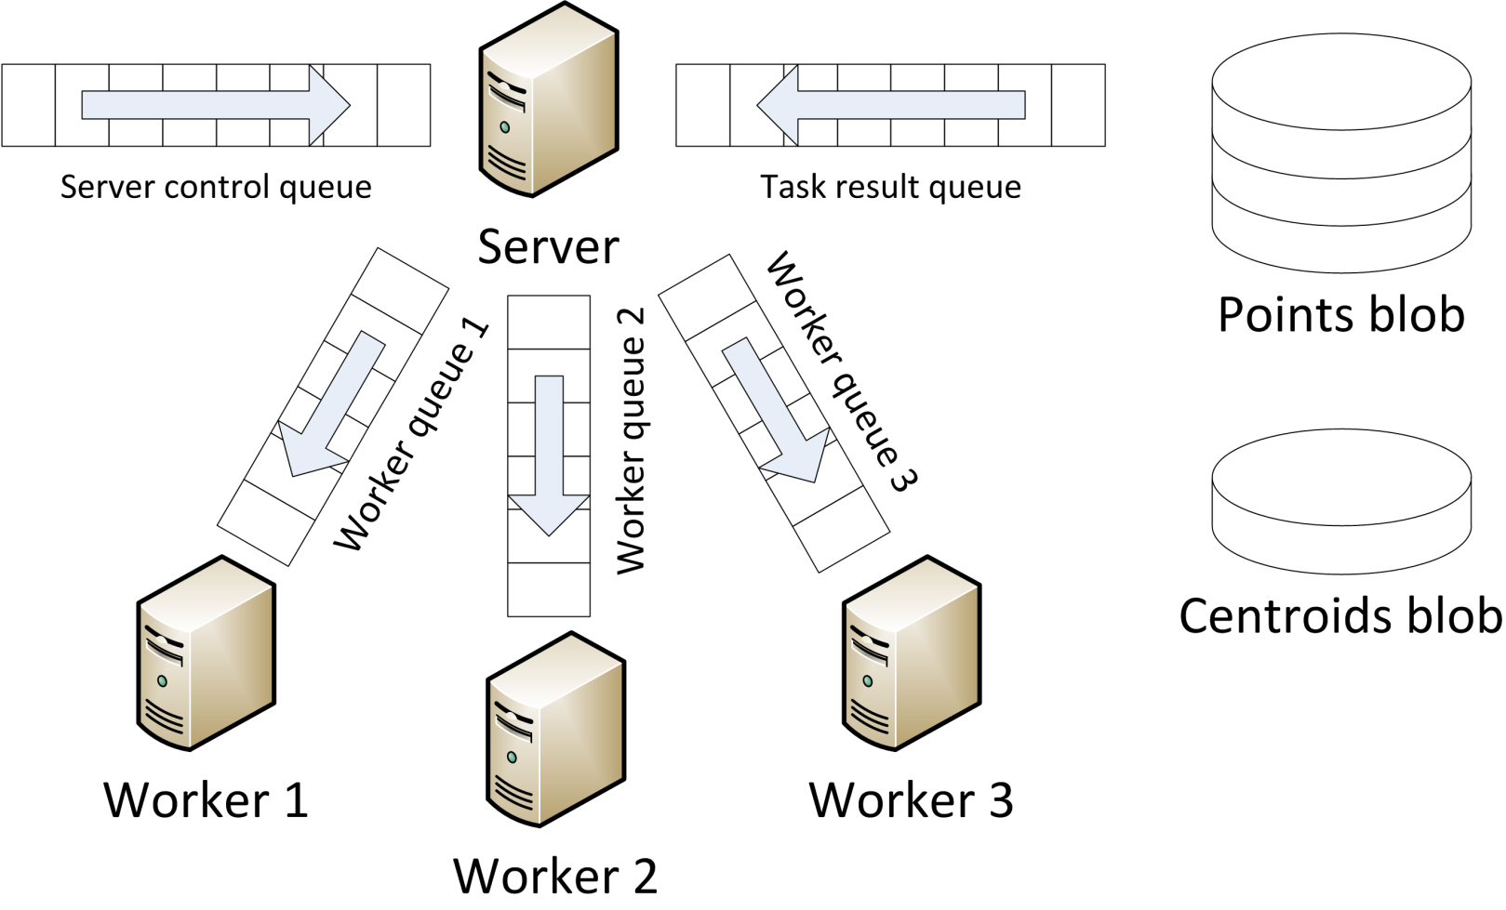
CloudClustering: Efficient Blob Concatenation
Notes:
One of the steps in CloudClustering is when each worker assigns each point in its partition to the closest centroid. The points in the old points blob have to be overwritten with the new ones. But Azure blobs don’t support random writes, so the workers can’t modify the blob in-place.

Slide 40
CloudClustering: Efficient Blob Concatenation
Notes:
One way of solving the problem might be to have each worker write to a separate, temporary blob. The server could then join all of the temporary blobs together by writing them sequentially into the original blob.
But this would mean reading and writing the full list of points unnecessarily, because the server would have to read all the points in and write them all out in order to join the temporary blobs. This takes time linear in the number of points.
A more efficient way is to take advantage of Azure’s block blobs. Each worker can upload its new point partition as one or more blocks on the points blob. The server then just has to join the list of block IDs from the workers and tell Azure to commit that. This takes constant time.

Slide 41
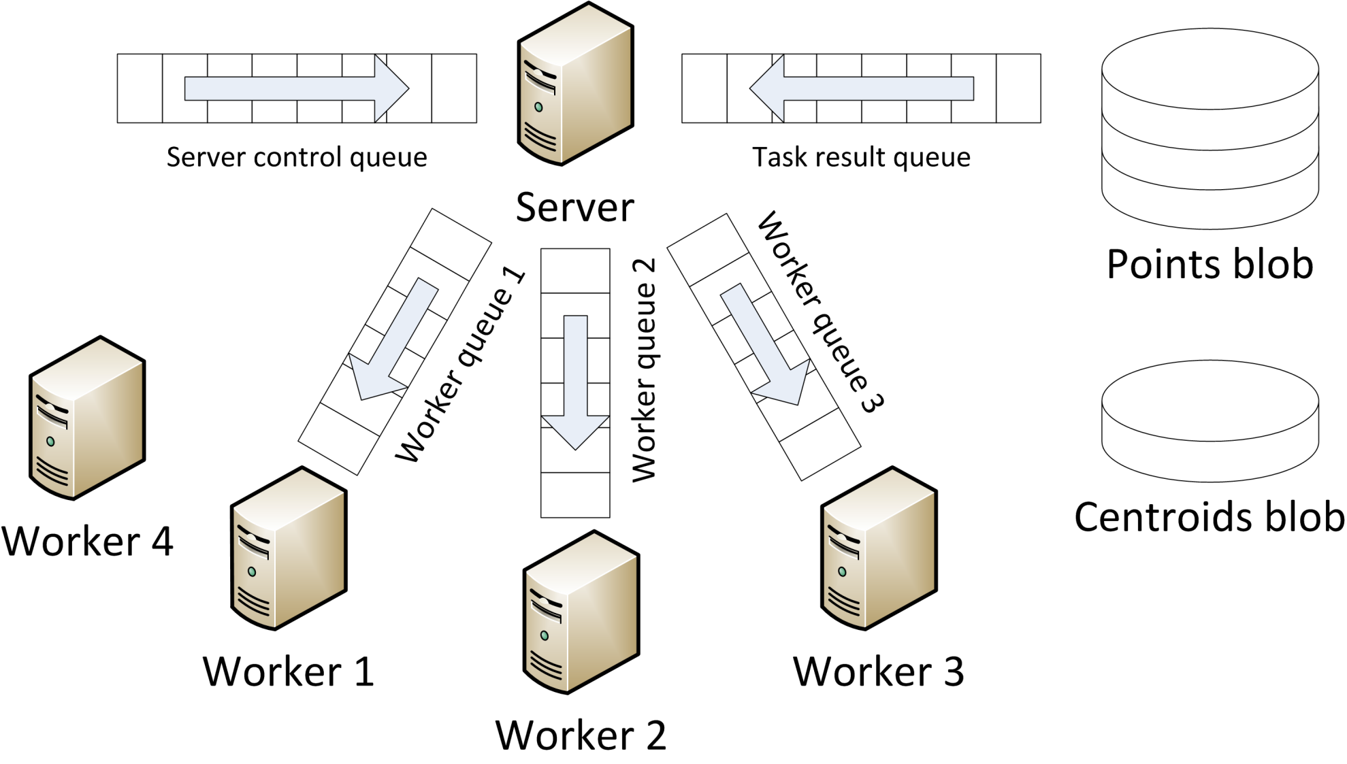
CloudClustering: Dynamic Scalability
Notes:
CloudClustering supports dynamic scalability – we can add or remove workers in the middle of a job, and the system will incorporate them.
As I mentioned, the workers announce themselves to the server by putting a message into the server control queue.
Then, at the beginning of each iteration when the server splits the points into partitions, it will take them into account and give them a piece of work.

Slide 42
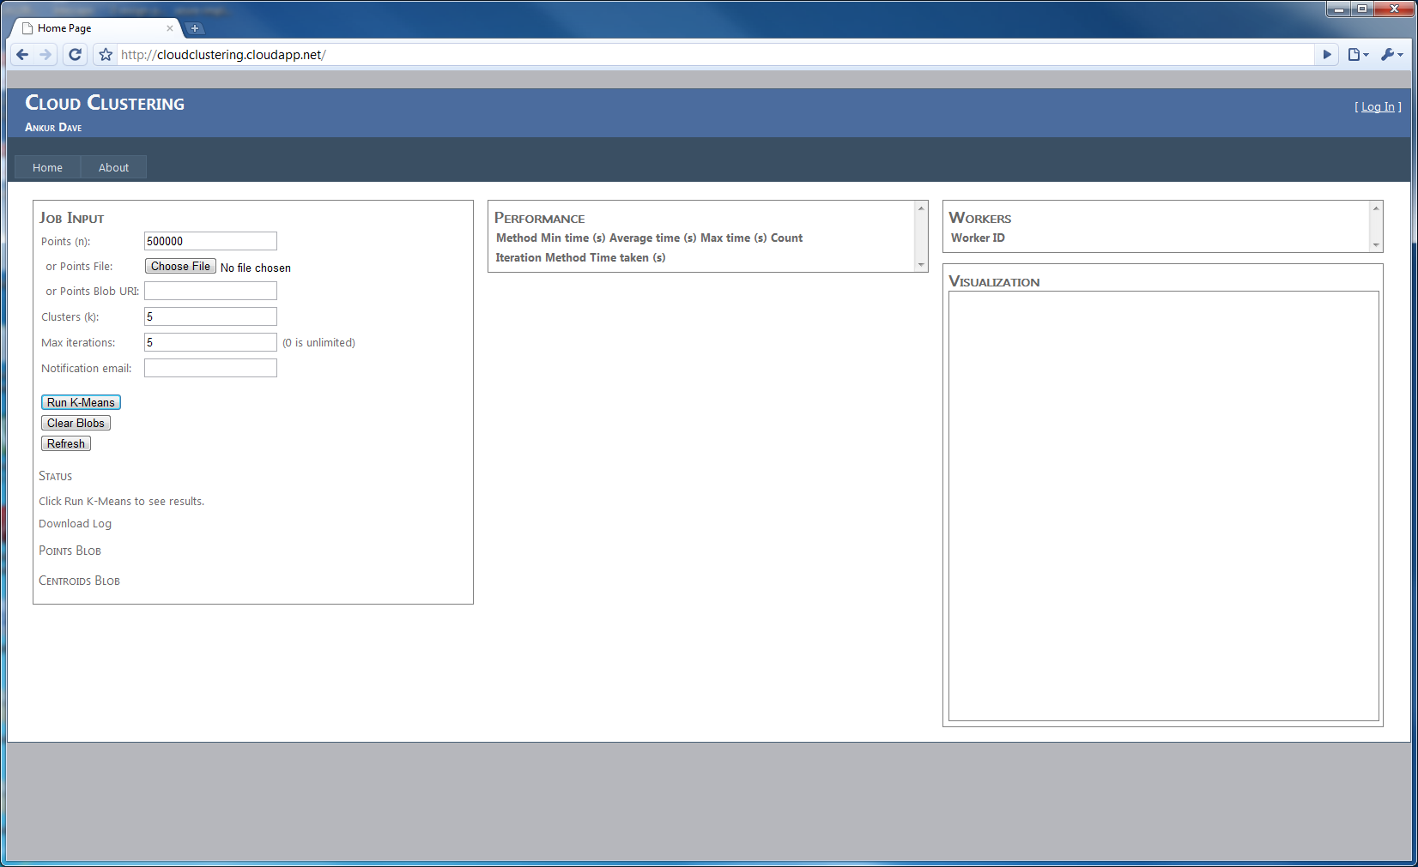
CloudClustering: Demo

Slide 43
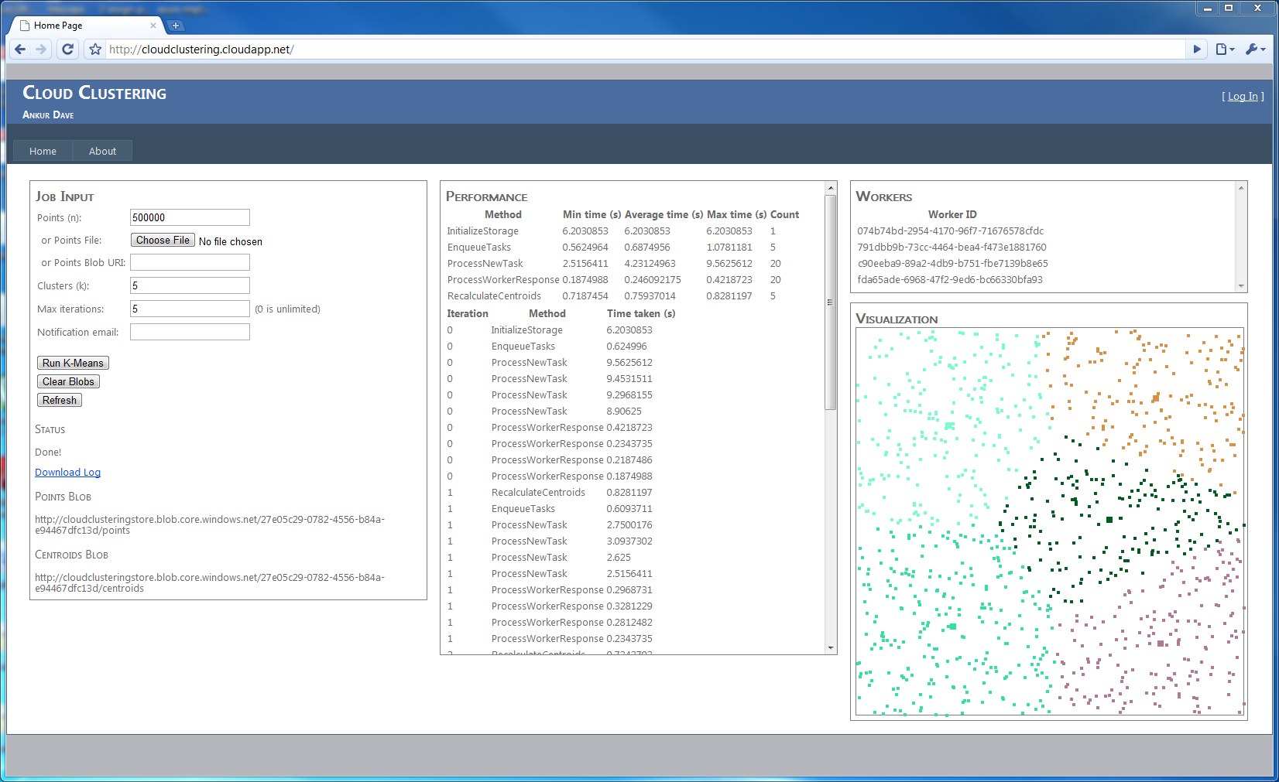
CloudClustering: Demo

Slide 44
Agenda
Notes:
Finally, let’s go into the results. The goal of this project was to gain experience with building data-intensive algorithms on Windows Azure.

Slide 45
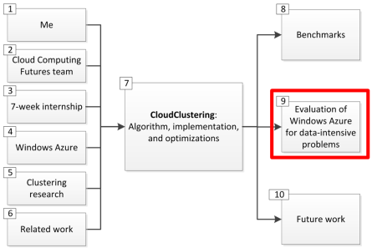
Windows Azure: Benefits
Infrastructure
Amazon EC2
Platform
Windows Azure
Framework
MapReduce
Azure is an appropriate level of abstraction for data-intensive algorithms like $k$-means.
Notes:
After building CloudClustering, we’ve concluded that Azure is an appropriate level of abstraction for data-intensive algorithms like k-means.
K-Means can be implemented on all three of these systems, but Azure sits in the “sweet spot” of abstraction.
Compared to MapReduce, it exposes functionality like local storage and multicore workers that allow significant performance optimizations.
Compared to EC2, it provides easy access to tools like .NET

Slide 46
Windows Azure: Potential Problem Areas
On the cloud, cost scales directly with usage
Sub-linear speedups are not good enough!
For data-intensive algorithms, data affinity gives great performance… but there’s a tradeoff
Dynamic scaling is more complex
Fault-tolerance is even harder
Performance test to find configuration sweet spots
Notes:
Azure also has several potential problem areas to be aware of.
Unlike in traditional clusters, on the cloud, cost scales directly with usage. We found that using multicore parallelism, we did get a speedup as we increased the instance size. But it was sublinear – and that’s not good enough. An eight-core ExtraLarge instance costs the same as eight Small instances.
Data affinity delivers a 2x speedup for Small size workers… but at the expense of scalability and fault-tolerance.
Scalability is complicated – we need one queue per worker
Fault-tolerance is even worse – we need something like a buddy system – more in future work
It’s very important to do performance testing with any data-intensive application to find the sweet spots in terms of instance size and instance count.

Slide 47
Agenda
Notes:
Here are the features for CloudClustering that needed more than the seven weeks that I had. I’d love to come back next summer and work on these! ☺

Slide 48
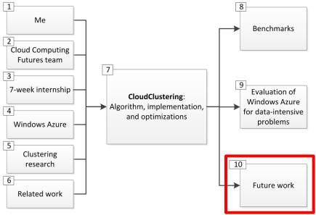
Future work
A compromise between worker pools and data affinity that retains scalability and fault-tolerance
Buddy system
Improved caching using blocks
Fundamental improvements to the $k$-means algorithm
More efficient stopping condition
“Lazy” processing that eliminates synchronization barriers
Further optimizations to multicore parallelism
Notes:
A compromise between worker pools and data affinity that retains scalability and fault-tolerance
Buddy system: Workers in different fault domains check each other’s status and take on the unfinished tasks left by a failed worker.
Improved caching using blocks
Currently, when cached data changes due to repartitioning when a new worker comes online, we don’t take advantage of possible overlap in the old and the new data. Storing cache in blocks, and reusing those, would take care of that.
Fundamental improvements to the $k$-means algorithm
More efficient stopping condition based on centroid movement rather than point movement. This would avoid constantly updating the central points blob.
“Lazy” processing that eliminates synchronization barriers. Workers could asynchronously update the centroids using partial information, instead of having a server wait for full information before recalculating.
Further optimizations to multicore parallelism that open up more IO channels than there are cores.

Slide 49
Ankur Dave
ankurdave@gmail.com
http://ankurdave.com

